Slide 1
Pre-school information – Discovering the world with young Children
Richterswil, Rosengartensaal, March 24th, 2026
Department «Gesellschaft» and «Integration»

Slide 2


Pre-school information
Discovering the world with young Children
Welcome by Melanie Züger, Council Member «Gesellschaft»
Evelyne Bucher, Director «Gesellschaft»
Kim Weber, «Integrationsbeauftragte»
Evelyne Bucher Kim Weber
Leiterin Gesellschaft Integrationsbeauftragte

Slide 3
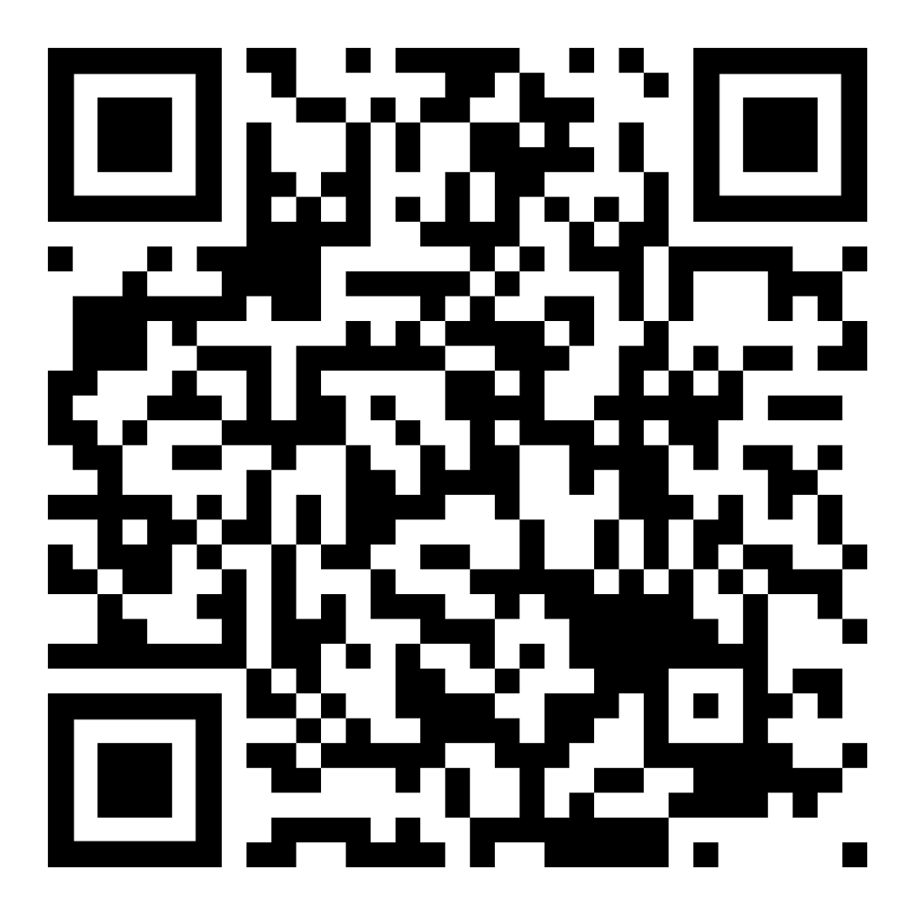
Why have a
„Pre-school information“?
Pre-school information
Presentation in German and English, as well as related links
Guidance and ideas for a supportive, playful family life
A wonderfully intense phase
Support and information resources

Slide 4
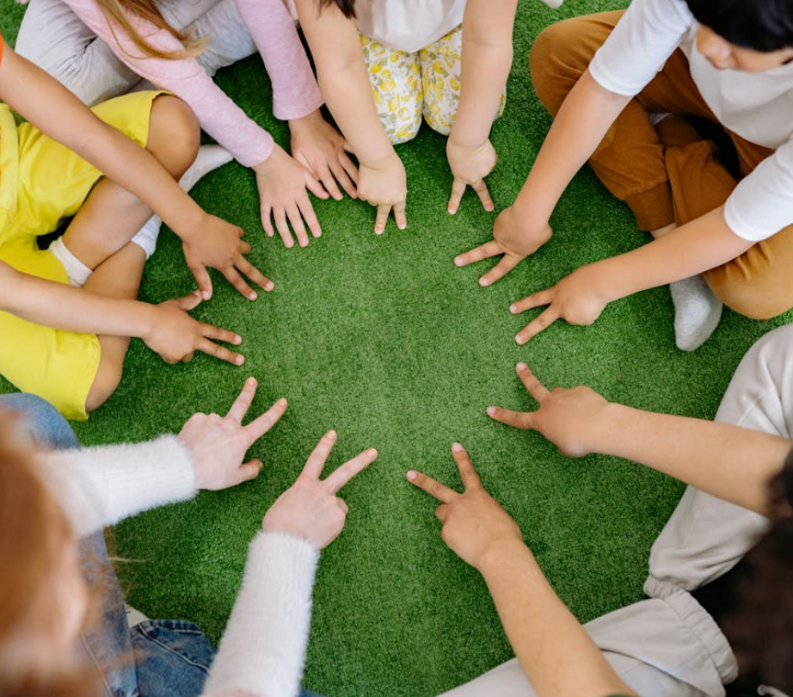
Daily life at pre-school («Kindergarten»)
Pre-school information
Starting pre-school is a major adjustment, no matter what situation the Children were in before.
The school’s orientation event, “Starting School” (“Eintritt in die Volksschule”), which focuses on the transition to pre-school, will take place in March 2027.
Get a glimpse into daily life at the pre-school with the pre-school teachers: Mirjam Kuhn, Mettlen 3 and Céline Gerig, Mettlen 4
Notes:
Evelyne

Slide 5


PRE-SCHOOL

Slide 6
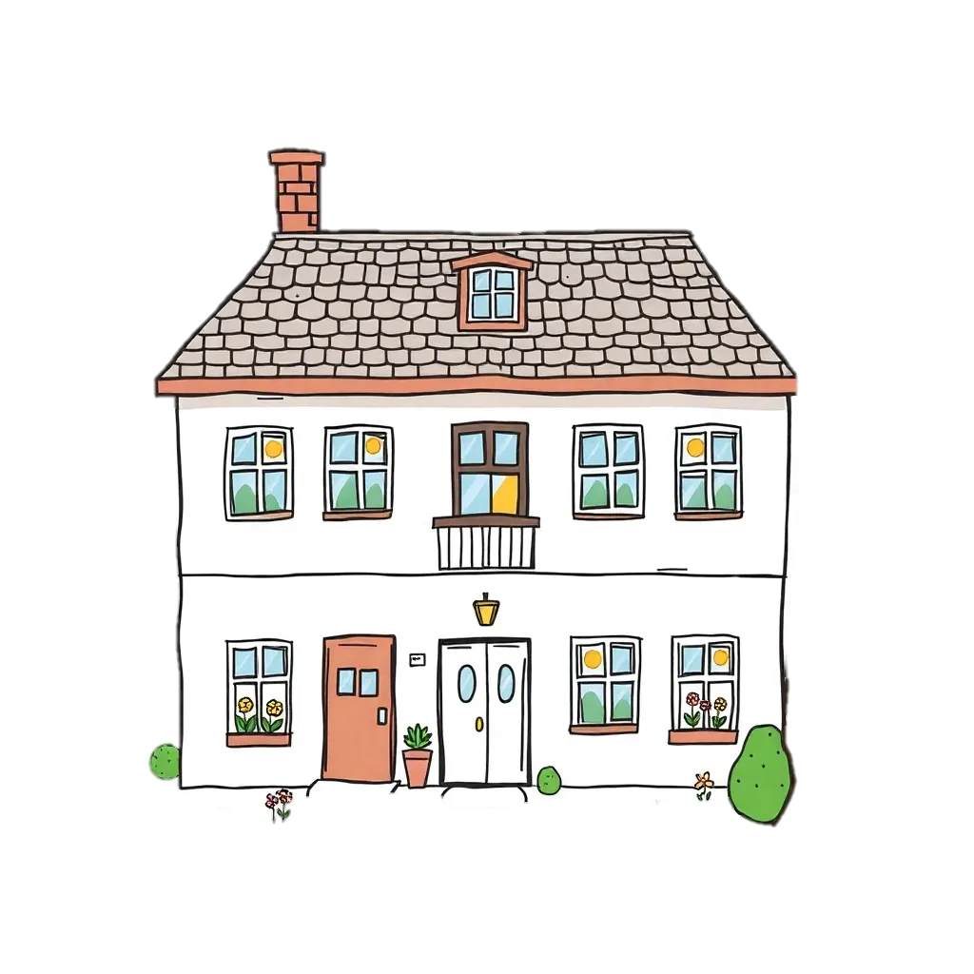

Hügsam 1
Hügsam 2
Reidholz 1
Reidholz 2
Samstagern
Feld 1
Feld 2
Leemann
Mettlen 1/Mettlen 2
Mettlen 3/Mettlen 4
Pre-schools in Richterswil-Samstagern
Grenzbach

Slide 7
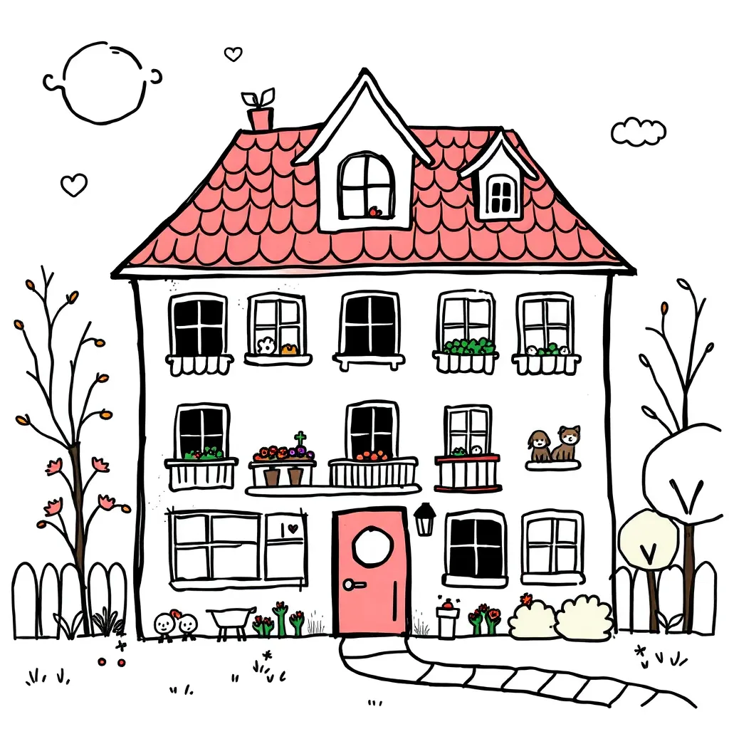
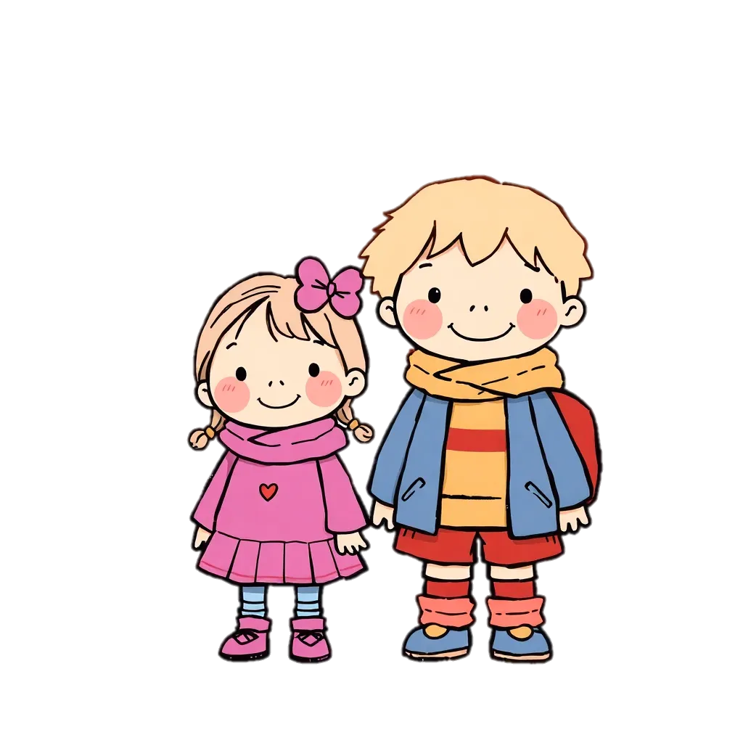
2 Years
Pre-school

Slide 8



8.15 – 11.50 o‘clock

Slide 9
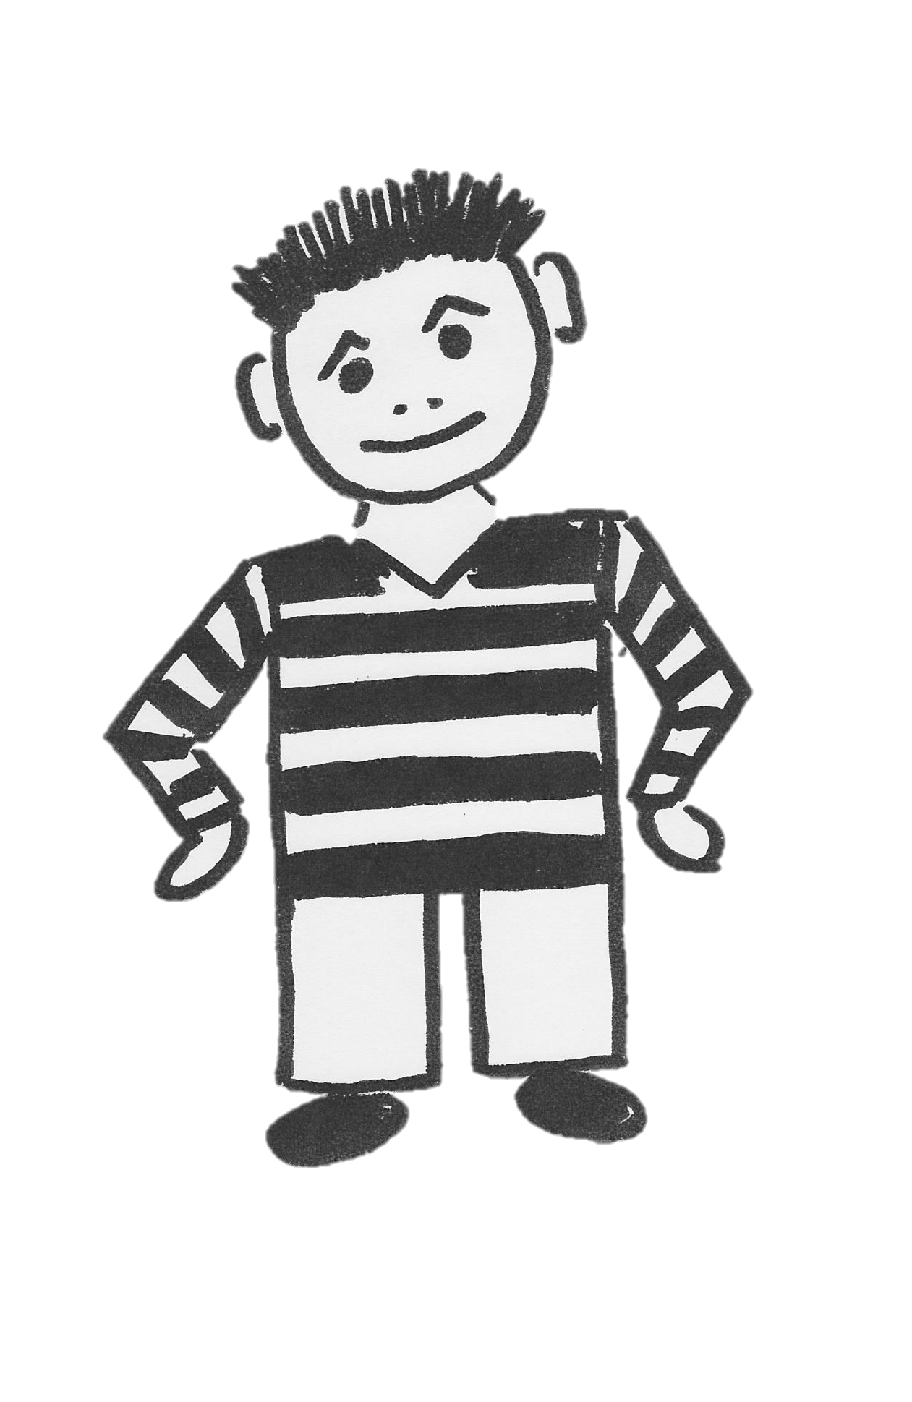
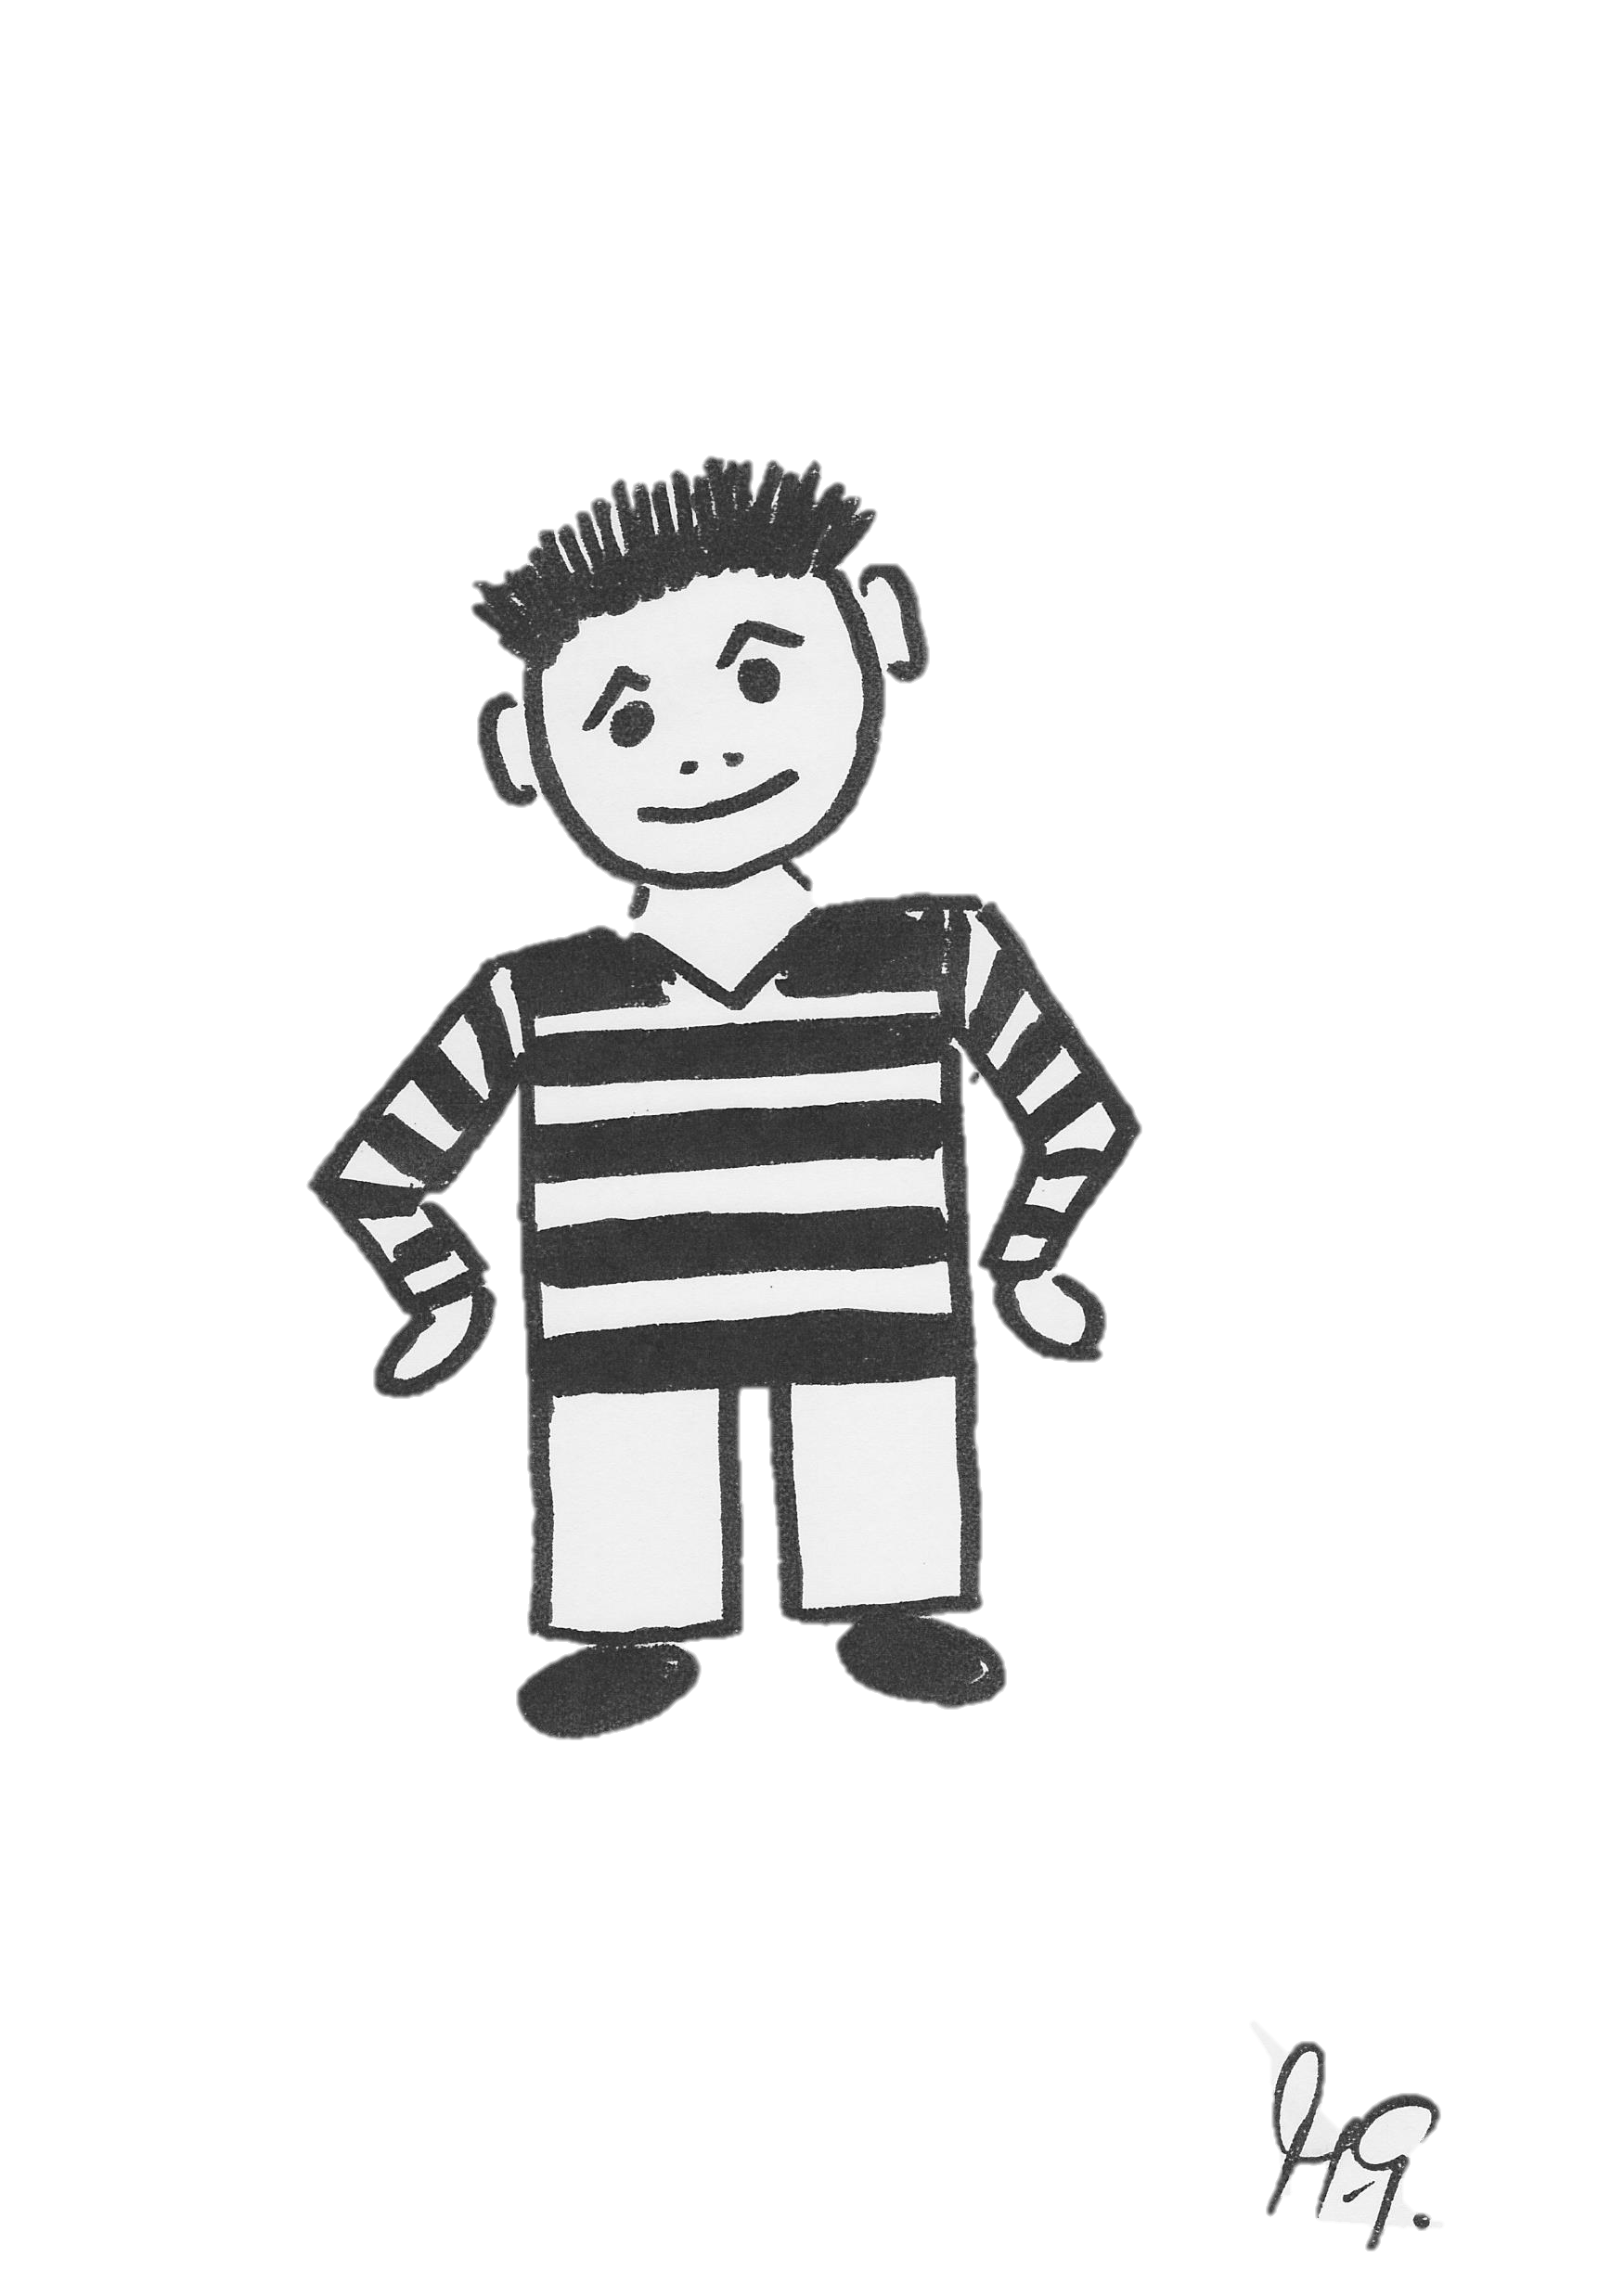

Slide 10

4 years old
born before July 31, 2023

Slide 11
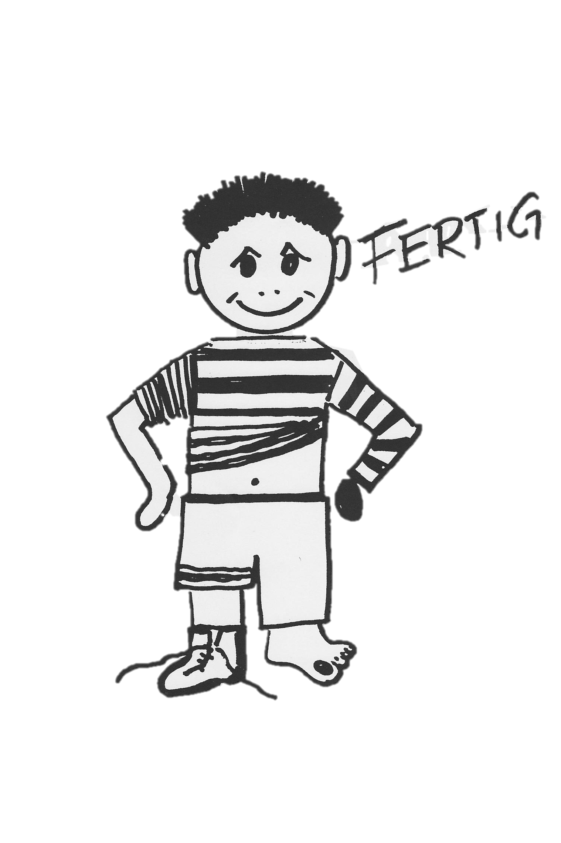
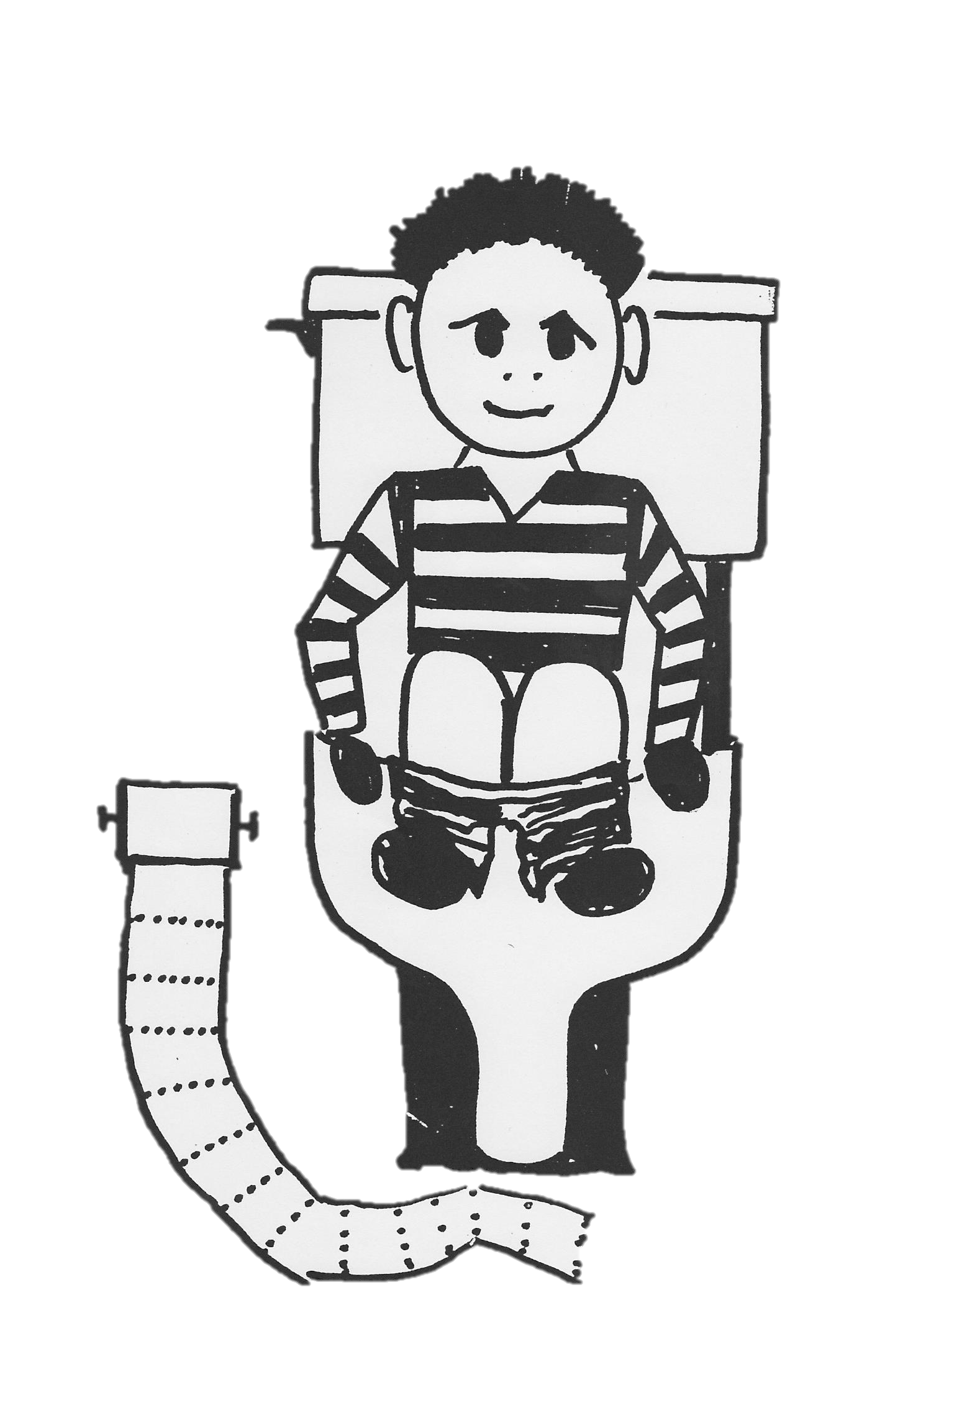
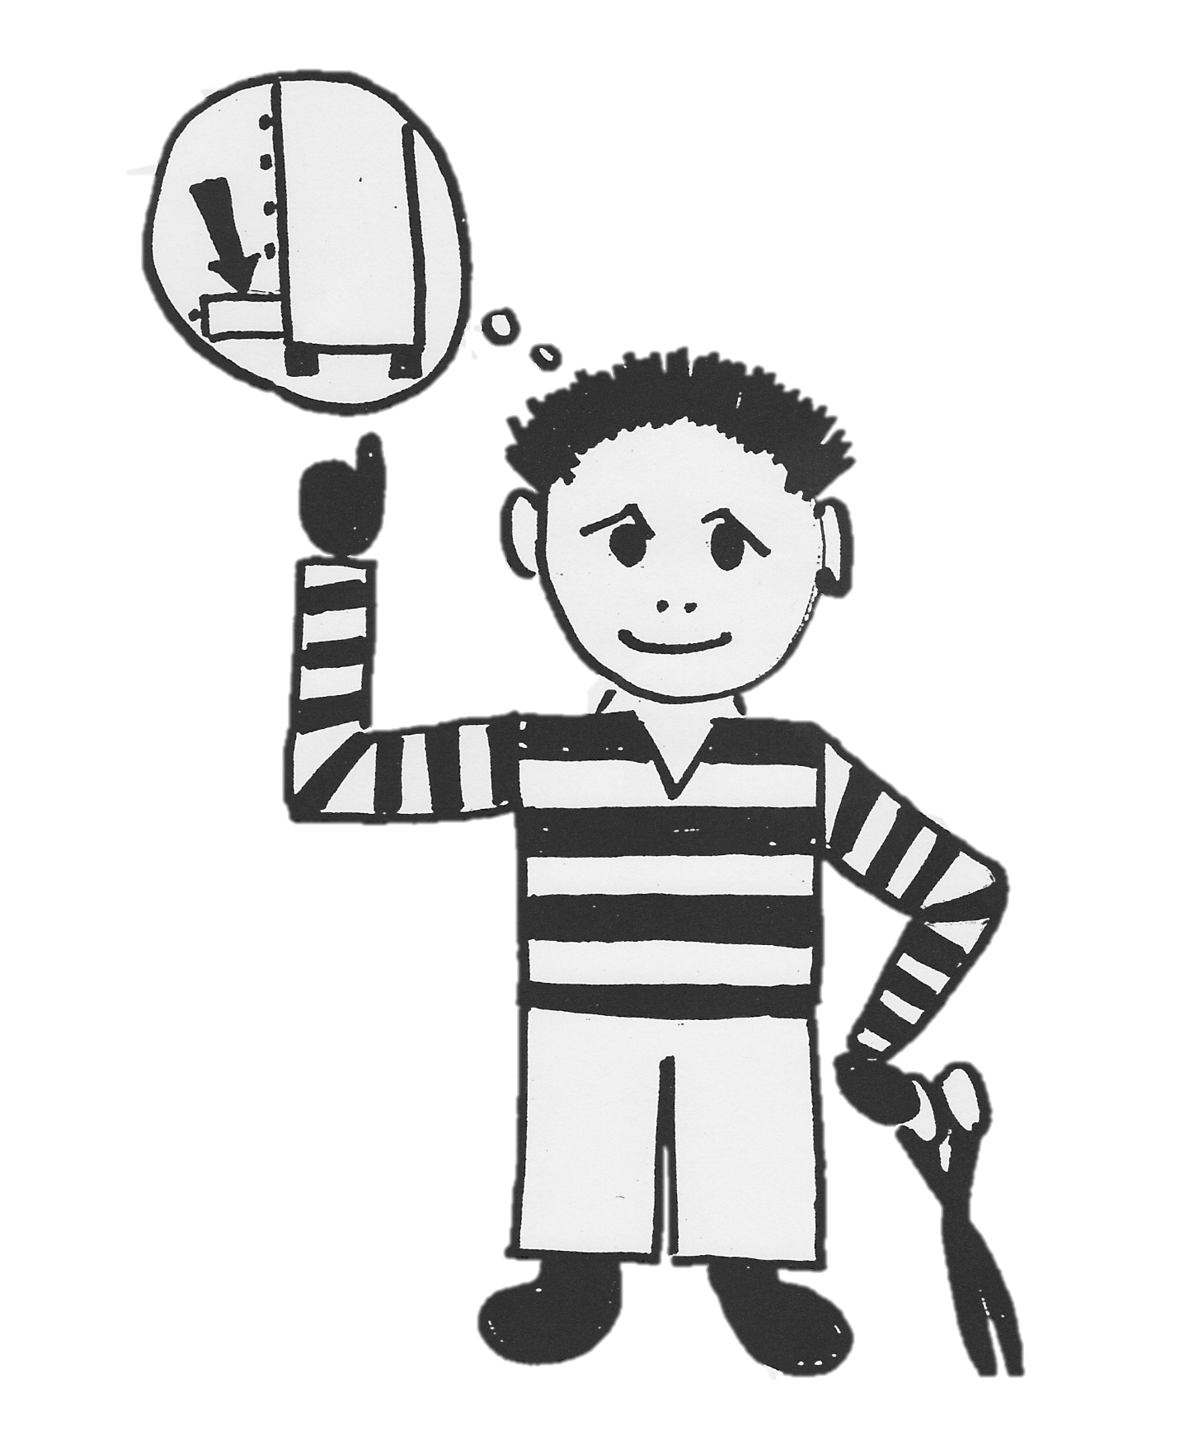

INDEPENDENCE

Slide 12
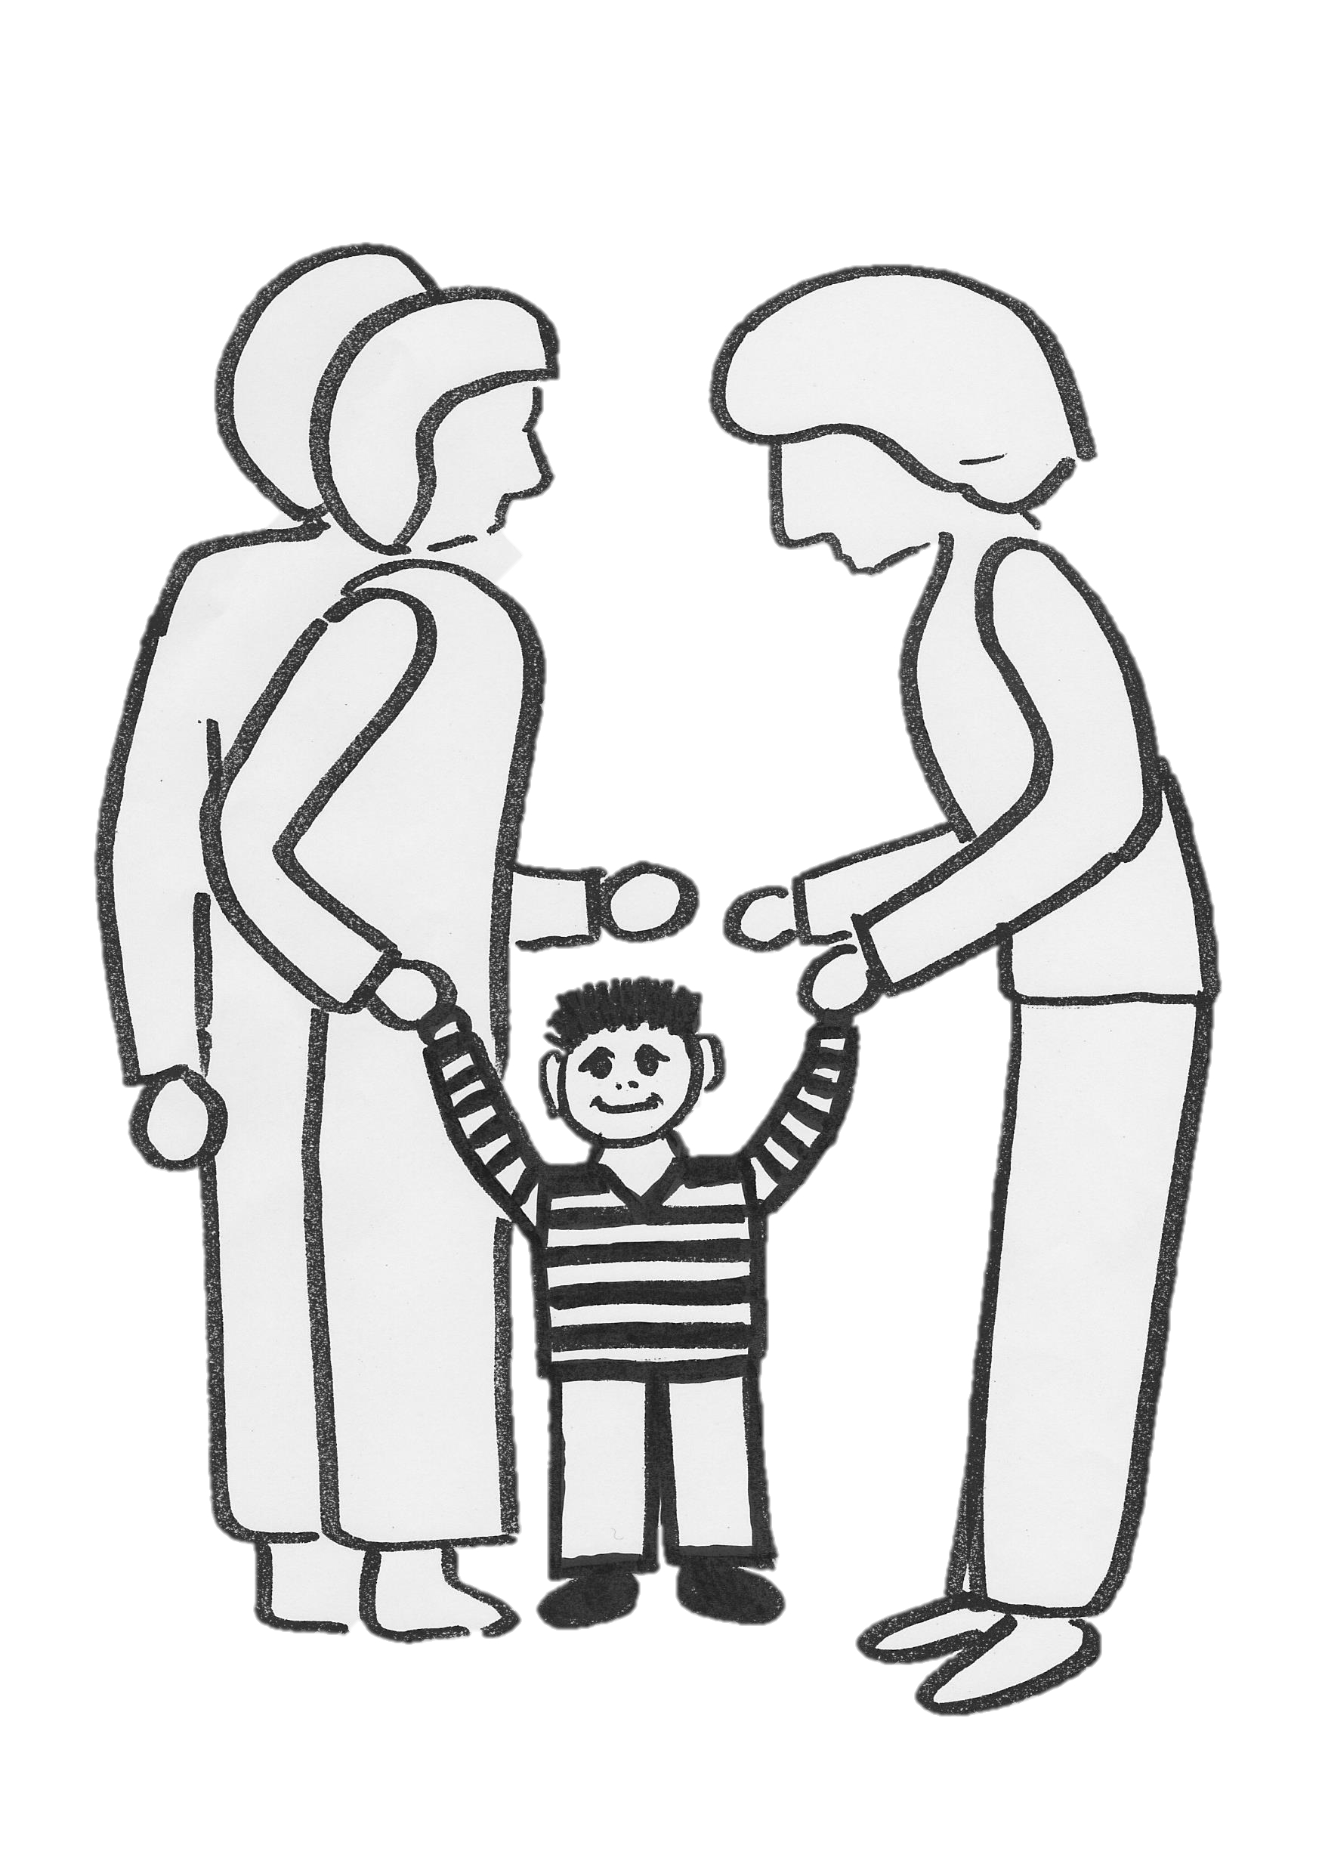


LET GO / TRUST

Slide 13
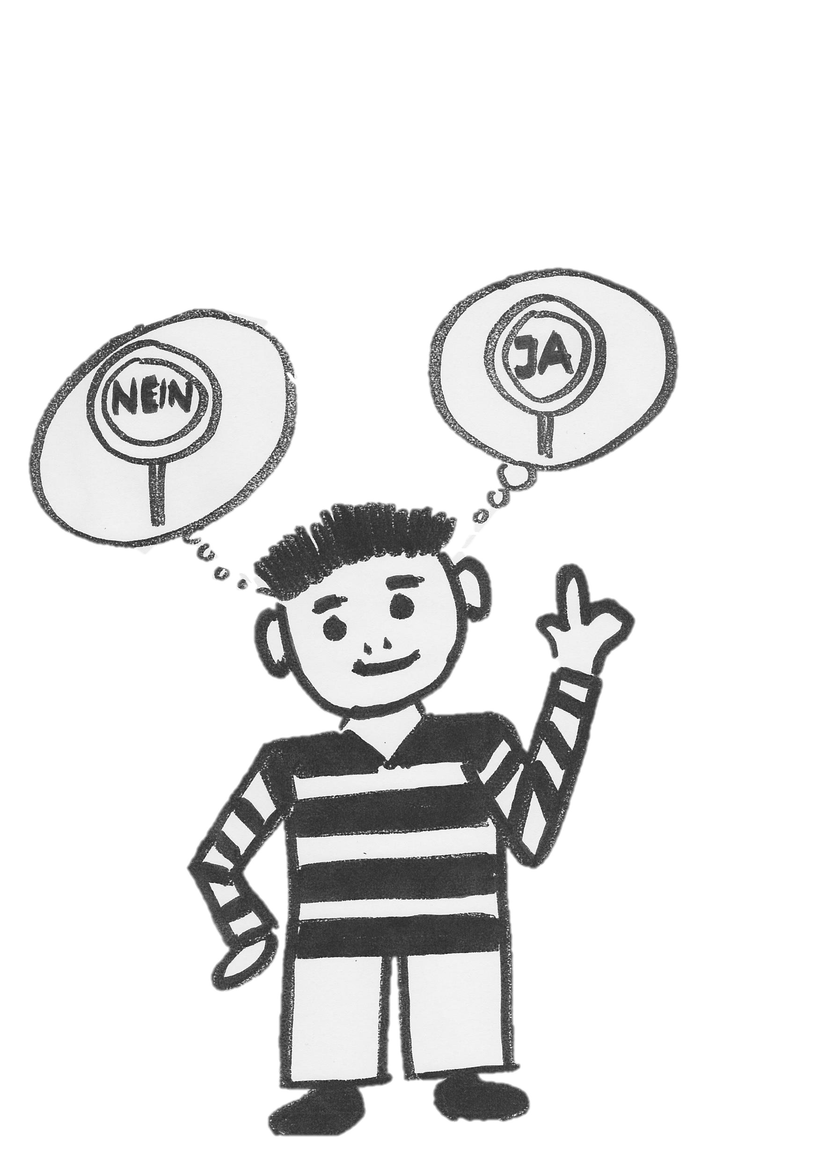
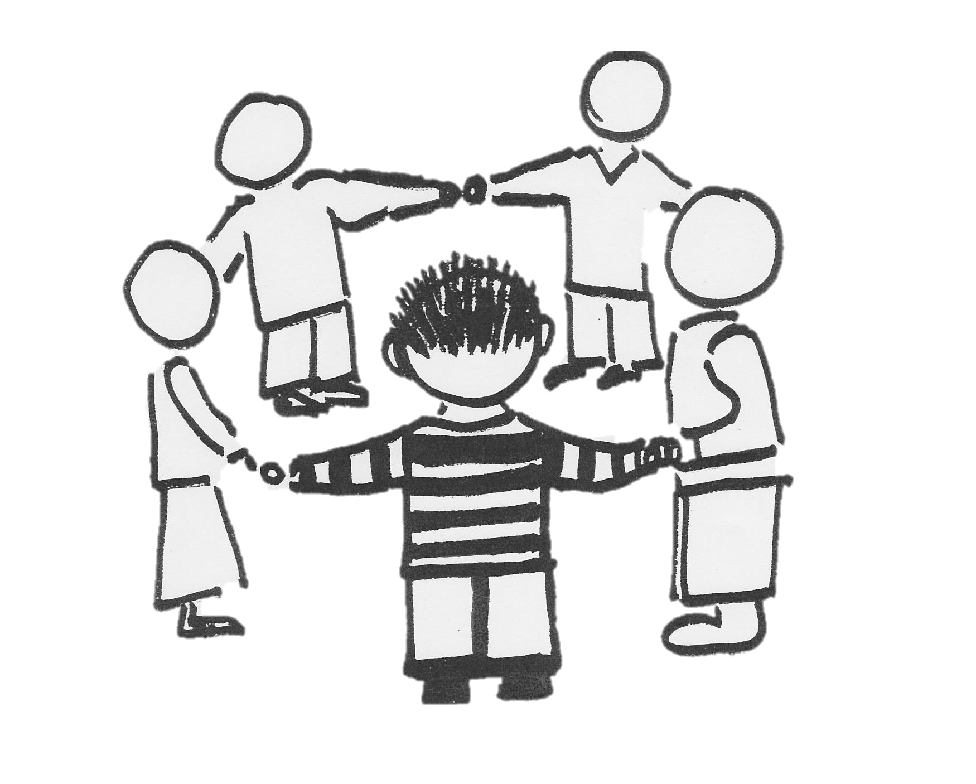
CHILDREN‘S GROUP / RULES

Slide 14
After-school care (“Schülerhort”)
Samstagern
Opening hours
6.45-18.00
Registration by
parents
Feld
Dorf

Slide 15
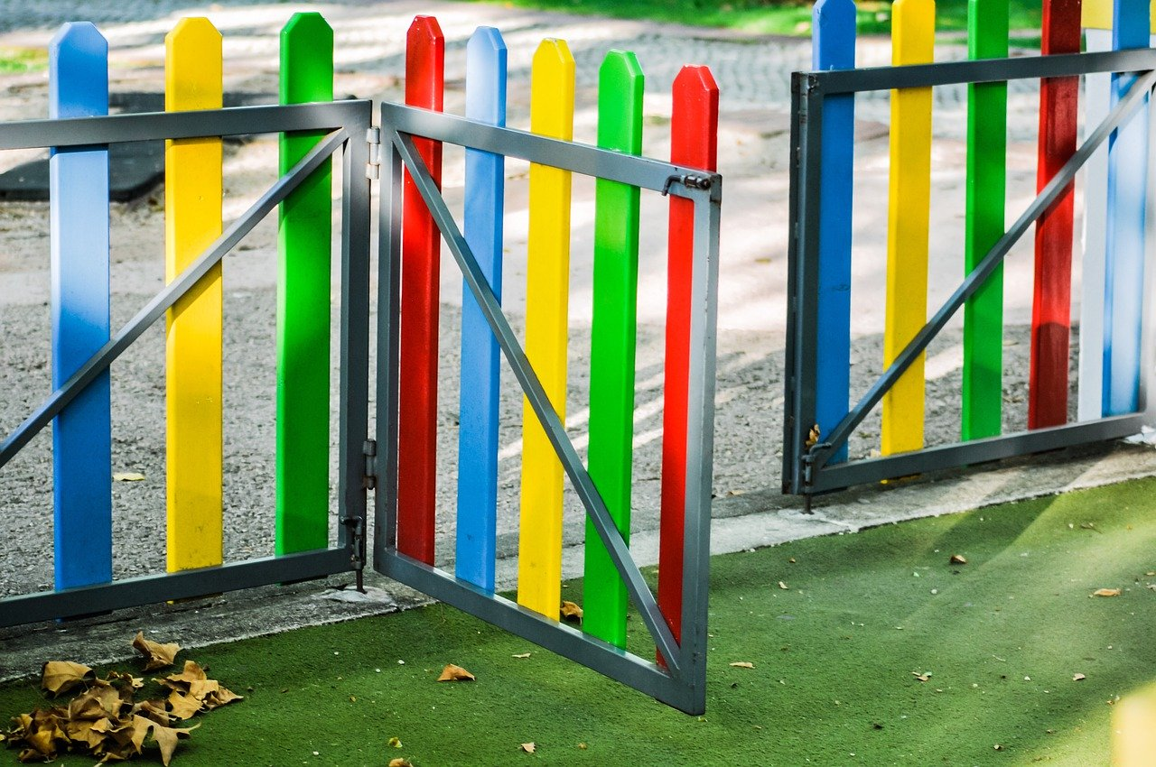

Slide 16

Questions for the pediatrician
Pre-school information
Dr. med. Zita Knobel, Pediatrician at the Richterswil Pediatric Practice
3-year inspection
4-year inspection
How to be involved as parents?
What is «normal»?
Barriers to pre-school enrollment

Slide 17

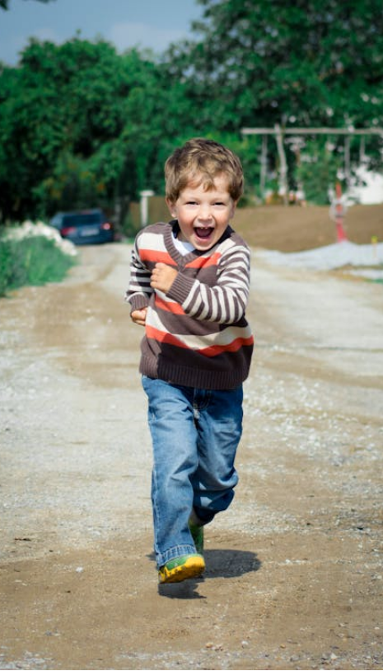
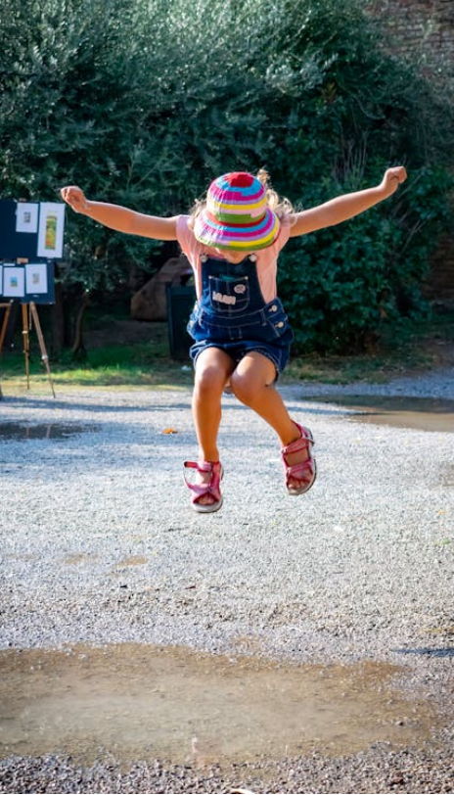
Developmental stages
Pre-school information
Autonomiesteigerung
Grob- und Feinmotorik
Was passiert
Kinder verstehen sich mehr und mehr als eigene Persönlichkeiten. Sie bauen ihren eigenen Willen aus. In jüngeren Jahren ist allerdings noch kein Perspektivenwechsel möglich.
Kinder wollen immer mehr selbst machen und haben einen Drang nach Freiheit. Die eigenen und elterlichen Grenzen werden ausgetestet, was z. T. mit Trotzen einhergehen kann. Kinder erfahren neue Emotionen und Erweitern ihre Impulskontrolle. Die Steigerung ihrer Selbstwirksamkeit führt zu mehr Selbstvertrauen und Selbständigkeit
Autonomy
Gross and fine motor skills
Body Awareness
Language acquisition
Social-emotional development

Slide 18
Developmental stages
Pre-school information
Autonomiesteigerung
Grob- und Feinmotorik
Was passiert
Kinder verstehen sich mehr und mehr als eigene Persönlichkeiten. Sie bauen ihren eigenen Willen aus. In jüngeren Jahren ist allerdings noch kein Perspektivenwechsel möglich.
Kinder wollen immer mehr selbst machen und haben einen Drang nach Freiheit. Die eigenen und elterlichen Grenzen werden ausgetestet, was z. T. mit Trotzen einhergehen kann. Kinder erfahren neue Emotionen und Erweitern ihre Impulskontrolle. Die Steigerung ihrer Selbstwirksamkeit führt zu mehr Selbstvertrauen und Selbständigkeit
Gross and fine motor skills
Social-emotional development
Language acquisition
Body Awareness
Autonomy

Slide 19
Autonomy
What is happening?
Development of one’s own personality
A stronger sense of independence
A desire for freedom
Testing one’s own and parents’ boundaries (e.g. through defiance)
Increased self-efficacy
Social-emotional development
Gross and fine motor skills
Body Awareness
Developmental stages
Language acquisition

Slide 20
Autonomy
Ideas for exploring Autonomy
Give children time
Don’t offer help right away, let them experience success
Children don’t always need to be entertained
Don’t take defiance personally
Offer both trust and guidance
Video: Car
Social-emotional development
Gross and fine motor skills
Body Awareness
Developmental stages
Language acquisition

Slide 21
Gross and fine motor skills
What is happening?
Fine motor skills
Developing the ability to work with one’s hands
Drawing becomes increasingly precise
Refinement of movements
Gross motor skills
Climbing, hopping, climbing stairs, balancing, riding a bike, playing with balls, walking backward, swimming, etc.
Improving physical coordination
Social-emotional development
Body Awareness
Autonomy
Language acquisition

Slide 22
Gross and fine motor skills
Ideas for exploring Motor skills
Crafting
Let them help out (cooking, baking, unloading the dishwasher, getting dressed, tying and untying buttons)
Provide toys with multiple uses
Go outside (in any weather) and explore nature, playgrounds, and the pool
The process is the goal, not the result!
Social-emotional development
Body Awareness
Autonomy
Language acquisition

Slide 23

Body Awareness
What is happening?
Rapid growth from 0 to 6 years
Changes in body proportions
Recognizing biological needs
Distinguishing between girls and boys, with some uncertainty
Gross and fine motor skills
Social-emotional development
Autonomy
Language acquisition

Slide 24
Body Awareness
Ideas for exploring different perceptions
Talking about perceptions
Identifying and Explaining personal boundaries
Respecting Children’s privacy
Providing opportunities for experiences
Video: Path
Gross and fine motor skills
Social-emotional development
Autonomy
Language acquisition

Slide 25
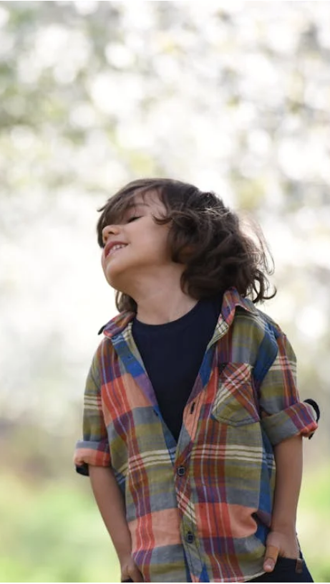
Language Acquisition
What is happening?
Remarkable progress in language acquisition (from two-word sentences to three-word sentences to full stories)
Extensive passive vocabulary
Development of the distinction between «I» and «you»
Language development and the joy of conversation occur through interaction with other people (not with (digital) media), through shared language experiences (mirroring, asking questions, responding to one antoher, adjusting the pace)
Gross and fine motor skills
Social-emotional development
Body Awareness
Autonomy

Slide 26
Language Acquisition
Ideas for exploring conversations
Conversations take time and undivided attention, but can happen anywhere
Speak your native language
Ask open-ended questions, comment on the child’s actions
Correct by repeating
Read books aloud, play role-playing games («Imagine…», shopkeeper games), sing together, rhyme, etc.
Describe feelings, introduce concepts of time, strengthen geographical understanding
Provide simple explanations, comparisons can help
No irony
Learning by example (manners, dialect, intonation)
Video: Library
Gross and fine motor skills
Social-emotional development
Body Awareness
Autonomy

Slide 27
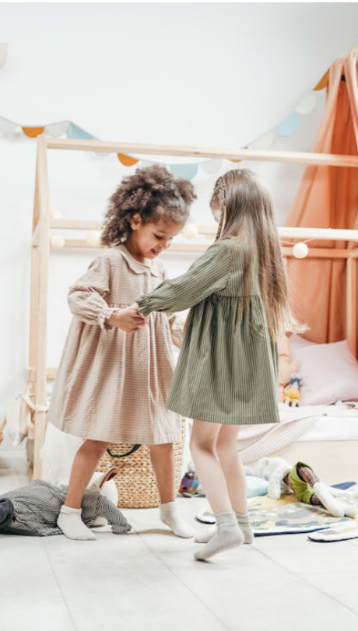
Social-emotional development
What is happening?
Relationships develop through playing with peers and engaging in shared activities
Recognizing the needs of others
The child learns to wait and share
Expressing their own wishes
Learning to say no
Expressing feelings verbally
Gross and fine motor skills
Body Awareness
Autonomy
Language acquisition

Slide 28
Social-emotional development
Ideas for discovering relationships
Facilitate interactions
Serve as a role model
Have multiple caregivers serve as different role models
Learning to argue takes practice: Don’t rush to resolve conflicts on their behalf
Refer to past experiences
Don’t take «arguments» personally, view a Child’s independent will as a strength
Have other adults help care for the children
Gross and fine motor skills
Body Awareness
Autonomy
Language acquisition

Slide 29
Discovering the world together
Pre-school information
The journey is the destination
Be a role model
Enjoy

Slide 30

Market hall
Pre-school information
KITA Richterswil / Samstagern
Tagesfamilienverein
ELKIDS (Eltern-Kind-Treff)
Ping:pong; Get ready for pre-school
Mütter-/ Väterberatung
Bibliothek Richterswil
Pre-school teachers
Pediatrician
Notes:
Evelyne

Slide 31
Thank you for your attention
Evelyne Bucher Kim Weber
Leiterin Gesellschaft Integrationsbeauftragte

Slide 32
Sources
Pre-school information
Videos Bildungsdirektion Kanton Zürich. Lerngelegenheiten für Kinder bis 4: https://www.kinder-4.ch/filmfinder
Bilder: pexels.com
Projuventute.ch: Entwicklungsschritte bei Ihrem Kind
Physical materials in the envelope:
  Feedback form
  QR code for the website and 2026 presentation
  Kids Want to Talk (short film inspirations)
  Brochure «Learning begins well before Kindergarten»
  Parentu: App for informed parents
  Activities for Children in Richterswil
  Activities for Children in the Horgen district
Kontakt
Evelyne Bucher, Director «Gesellschaft», evelyne.bucher@richterswil.ch
Kim Weber, «Integrationsbeauftragte», kim.weber@richterswil.ch

